Slide 1
Coimbra Group, a tradition of innovation

Slide 2
Coimbra Group: commitment
Founded in 1985 the Coimbra Group is an association of long-established European multidisciplinary universities of high international standard.
The Coimbra Group is committed to creating special academic and cultural ties in order to promote internationalisation, academic collaboration, excellence in learning and research, and service to society.
It is also the purpose of the Group to influence European educational policy and to develop best practice through mutual exchange of experience.

Slide 3
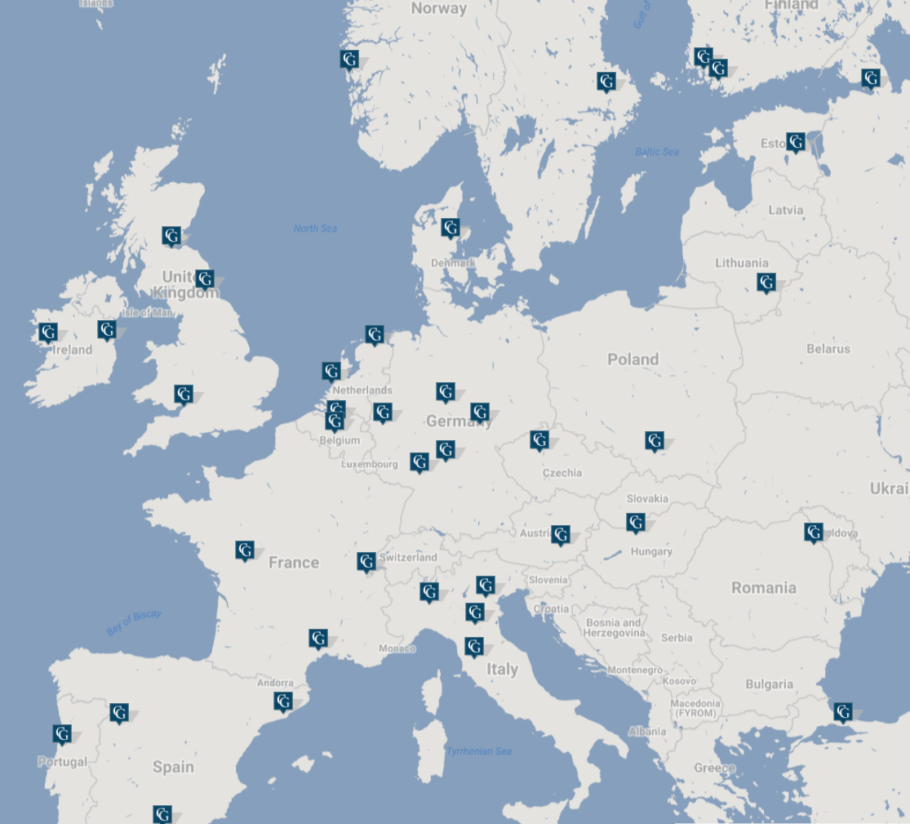
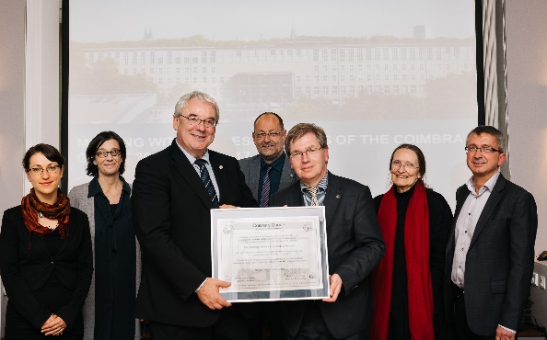
Coimbra Group: facts and figures
39 Universities from 23 European countries
>1,4M students
>226 000 staff (teaching, research, admin.)
The latest overview (2014), showed that 36 000 students had undertaken Erasmus mobility to/from CG universities (16% of all Erasmus students in Europe)
Multi-billion € total annual Research budget
26/10/17: University of Cologne, new CG member

Slide 4
Coimbra Group: members
Aarhus (DK)
Barcelona (ES)
Bergen (NO)
Bologna (IT)
Bristol (UK)
Budapest (HU)
Coimbra (PT)
Dublin (IE)
Durham (UK)
Edinburgh (UK)
Galway (IE)
Genève (CH)
Göttingen (DE)
Granada (ES)
Graz (AT)
Groningen (NL)
Heidelberg (DE)
Iaşi (RO)
Istanbul (TR)
Jena (DE)
Köln (DE)
Kraków (PL)
Leiden (NL)
Leuven (BE)
Louvain (BE)
Montpellier (FR)
Padova (IT)
Pavia (IT)
Poitiers (FR)
Prague (CZ)
St. Petersburg (RU)
Salamanca (ES)
Siena (IT)
Tartu (EE)
Turku (FI)
Uppsala (SE)
Vilnius (LT)
Würzburg (DE)
Åbo (FI)

Slide 5
Coimbra Group: organisation chart
Working Groups (each composed by representatives of member universities – from 8 to 35 people)
by pillar of primary interest
Research | Education | Outreach
Research Support Officers Social Sciences & Humanities Life Sciences Science, Technology, Engineering and Mathematics (STEM) | Doctoral Studies Education Innovation Academic Exchange and Mobility Employability | Heritage Development Cooperation Latin America
Coordination by Executive Board members
Support from policy officers at CG Office (Brussels)

Slide 6
Coimbra Group: new Working Group structure, since 2015
WG | Activities
Latin America (LA) | Continuation of successful previous LA Task Force Link with Coimbra Group of Brazilian Universities (CGUB) and Grupo Montevideo New exchange programme for PhD Students and Researchers between CG and CGUB

Slide 7
Coimbra Group: Activities
Recent and future network-wide events:
CG-UNICA “Navigate your career!” international training workshop for PhD candidates (15-18 Oct. 2017, Dubrovnik)
High Level Seminar on Education Policy for Rectors and Vice-Rectors on “Internationalisation of the Curriculum” (13-14 Nov. 2017, Dublin)
High Level Workshop on Lifelong Learning and Employability with European Parliament (24 Jan. 2018, Brussels)
Annual Meeting with General Assembly in Salamanca in conjunction with USAL 800th anniversary (30 May – 1 June 2018)
High Level Seminar for Research Policy on “Impact of Research and Innovation: definitions and metrics” (6-7 Dec. 2018, Venice)

Slide 8
Coimbra Group: Higher Education and Research Policy
Recent policy and position papers:
Position paper on the mid-term review of Horizon 2020 European Research and Innovation Programme (11 Jan. 2017)
Position paper on the mid-term review of Erasmus+ Programme (23 May 2017)
First response to the “Lab-Fab-App” report on post-H2020 Research and Innovation programme (1 Sept. 2017)
Position paper on the future Research and Innovation Programme – FP9 (10 Oct. 2017)

Slide 9
Coimbra Group: Unibo participation
Unibo contact person is the Director of International relation Office
Members of Unibo participate in the general assemblies, to relevant policy seminars and the activities of the following working group:
Participation involves both professors and administrative staff
Intensive participation | weak participation
Academic Exchange and Mobility Development cooperation | Latin America Doctoral studies Research Support Officers

Slide 10
Coimbra Group: which is the value added?
Important stakeholder towards European Commission (especially for mobility)
Exchange of good practice as part of working group activities
Close ties with some universities at different levels (institutional, administrative, also disciplinary)
Participation to events on relevant “transversal” topics for higher education institutions (internationalization, research, employability etc.)
Logistic base in Brussels

Slide 11
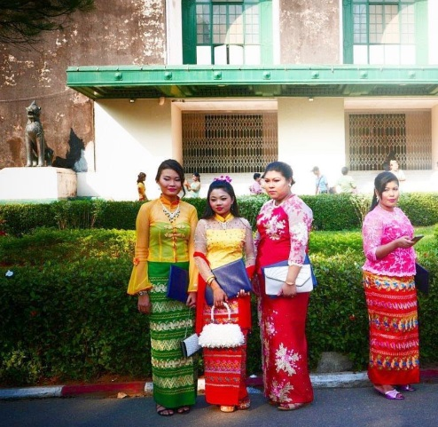
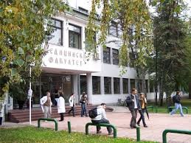
Joint intensive programme in Myanmar and Serbia
Thanks to Erasmus plus ICM financial support, UNIBO staff participate to two joint events in third countries:
- an intensive programme in Myanmar in order to support local universities on strengthening governance and management university practices. The project involves 4 CG universities
- A Summer School in Novi Sad (Serbia) to promote the idea of European multilingualism and intercultural linguistic education with the involvement of professors from 5 CG universities (representing different Eu languages)

Slide 12
Joint initiatives wg academic exchange and mobility
Safety protocols
Focus group with the aim to benchmarking good practices and procedures
Preparation of a guide for CG universities on best practices in dealing with emergency situations and mobility to unsecure contexts
Submission of an Erasmus+ KA2 project (strategic partnership)

Slide 13
Coimbra Group, a Tradition of Innovation
Contact: Brussels Office
Egmontstraat 11, rue d'Egmont - 1000 Brussels - Belgium
Tel : +32 2 513 83 32
www.coimbra-group.eu

